Slide 1
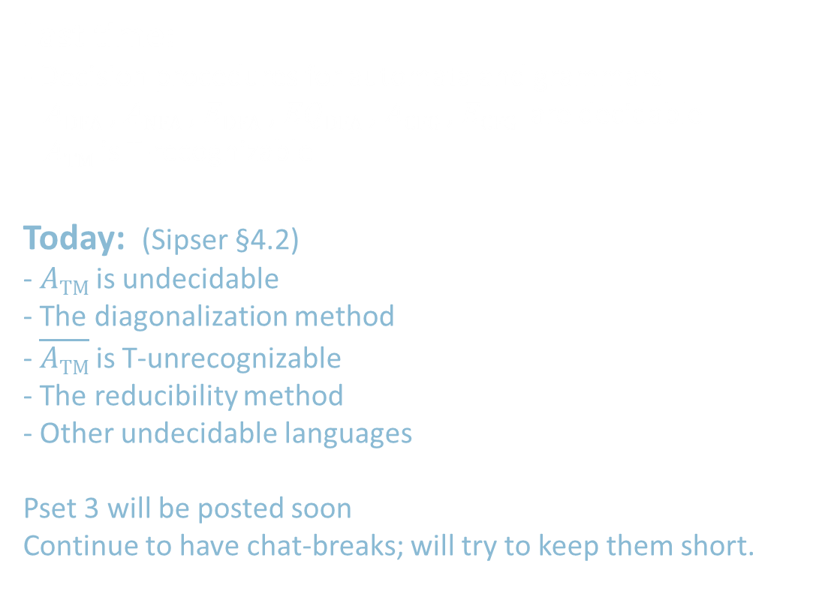
18.404/6.840 Lecture 8
Last time:
- Decision procedures for automata and grammars
$A\text{DFA}$ , $A\text{NFA}$ , $E\text{DFA}$ , $EQ\text{DFA}$ , $A\text{CFG}$ , $E\text{CFG}$ are decidable
$A\text{TM}$ is T-recognizable
Today: (Sipser §4.2)
- $A\text{TM}$ is undecidable
- The diagonalization method
- $\overline{A\text{TM}}$ is T-unrecognizable
- The reducibility method
- Other undecidable languages
Pset 3 will be posted soon
Continue to have chat-breaks; will try to keep them short.

Slide 2
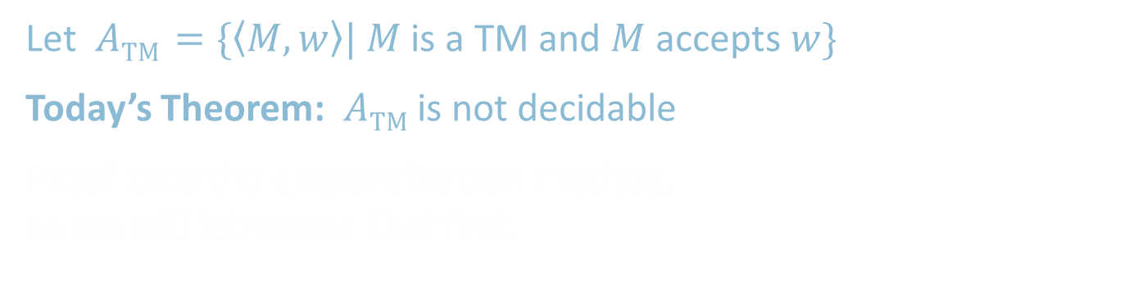
Recall: Acceptance Problem for TMs
Let $A\text{TM}$ $=\{〈M,w〉| M$ is a TM and $M$ accepts $w\}$
Today’s Theorem: $A\text{TM}$is not decidable
Proof uses the diagonalization method,
so we will introduce that first.

Slide 3
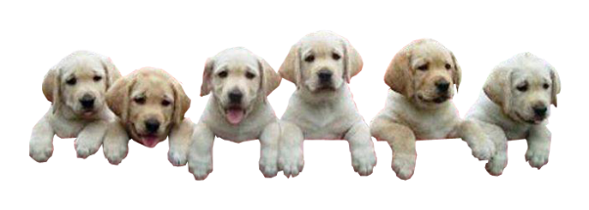
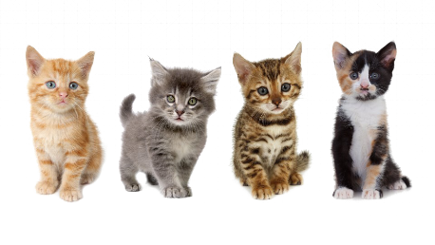







The Size of Infinity
How to compare the relative sizes of infinite sets?
Cantor (~1890s) had the following idea.
Defn: Say that set $A$ and $B$ have the same size if there is
a one-to-one and onto function $f:A→B$
Informally, two sets have the same size if we can pair up their members.
This definition works for finite sets.
Apply it to infinite sets too.
$$x≠y→$$
$$f\left(x\right)≠f\left(y\right)$$
“injective”
Range $(f)=B$
“surjective”
We call such an $f$ a 1-1 correspondence
$f$:

Slide 4




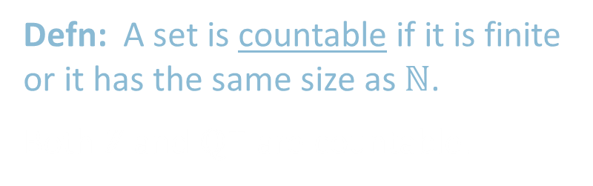


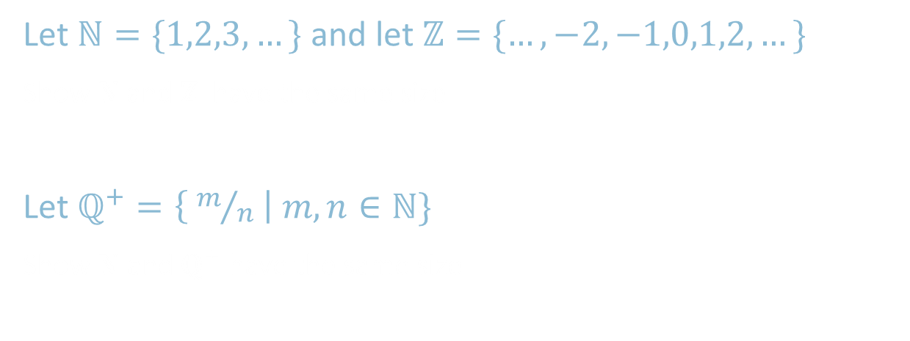

Countable Sets
Let $ℕ=\{1,2,3,…\}$ and let $ℤ=\{…,−2,−1,0,1,2,…\}$
Show $ℕ$and $ℤ$ have the same size
Let $ℚ^{+}=\left\{ m/n \right| m,n∈ℕ\}$
Show $ℕ$ and $ℚ^{+}$ have the same size
$$n$$ | $$f(n)$$
1 | 0
2 | -1
3 | 1
4 | -2
5 | 2
6 | -3
7 | 3
$⋮$ | $⋮$
$$ℕ$$
$$ℤ$$
$$n$$ | $$f(n)$$
1 | 1/1
2 | 2/1
3 | 1/2
4 | 3/1
5 | 3/2
6 | 2/3
7 | 1/3
$⋮$ | $⋮$
$$ℚ^{+}$$ | 1 | 2 | 3 | 4 | …
1 | 1/1 | 1/2 | 1/3 | 1/4
2 | 2/1 | 2/2 | 2/3 | 2/4 | …
3 | 3/1 | 3/2 | 3/3 | 3/4
4 | 4/1 | 4/2 | 4/3 | 4/4
$$⋮$$ |  | $$⋮$$
$$ℕ$$
$$ℚ^{+}$$
Defn: A set is countable if it is finite or it has the same size as $ℕ$.
Both $ℤ$ and $ℚ^{+}$ are countable.

Slide 5
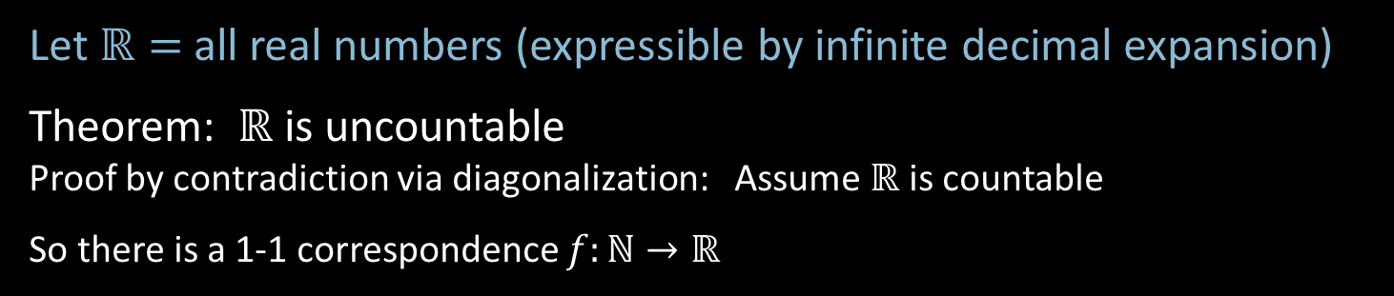



$ℝ$ is Uncountable – Diagonalization
Let $ℝ=$all real numbers (expressible by infinite decimal expansion)
Theorem: $ℝ$ is uncountable
Proof by contradiction via diagonalization: Assume $ℝ$ is countable
So there is a 1-1 correspondence $f:ℕ→ℝ$
$$n$$ | $$f(n)$$
1 | 2.718281828…
2 | 3.141592653…
3 | 0.000000000…
4 | 1.414213562…
5 | 0.142857242…
6 | 0.207879576…
7 | 1.234567890…
$⋮$ | $$⋮$$
Demonstrate a number $x∈ℝ$ that is missing from the list.
$x=$ 0.8516182…
differs from the $n$^{th} number in the $n$^{th} digit
so cannot be the $n$^{th} number for any $n$.
Hence $x$ is not paired with any $n.$ It is missing from the list.
Therefore $f$ is not a 1-1 correspondence.
7
≠4
≠7
≠0
≠2
≠5
≠9
≠8
4
0
2
5
9
8
Diagonalization

Slide 6




$ℝ$ is Uncountable – Corollaries
Let $ℒ=$all languages
Corollary 1: $ℒ$ is uncountable
Proof: There’s a 1-1 correspondence from $ℒ$to $ℝ$ so they are the same size.
Observation: $Σ^{∗}=\{ε, 0,1,00,01,10,11,000, …\}$ is countable.
Let $ℳ=$all Turing machines
Observation: $ℳ$ is countable.
Because $\left\{〈M〉\right| M$ is a TM$\}⊆Σ^{∗}$.
Corollary 2: Some language is not decidable.
Because there are more languages than TMs.
We will show some specific language $A\text{TM}$ is not decidable.
Check-in 8.1
Hilbert’s 1st question asked if there is a set of intermediate size between $ℕ$ and $ℝ$. Gödel and Cohen showed that we cannot answer this question by using the standard axioms of mathematics.
How can we interpret their conclusion?
We need better axioms to describe reality.
Infinite sets have no mathematical reality so Hilbert’s 1st question has no answer.
$$Σ^{∗}$$ | {$ε$, | 0, | 1, | 00, | 01, | 10, | 11, | 000, | …
$$A∈ℒ$$ | { | 0, |  | 00, | 01, |  |  |  | …
$$f\left(A\right)$$ | .0 | 1 | 0 | 1 | 1 | 0 | 0 | 0 | …
Check-in 8.1

Slide 7


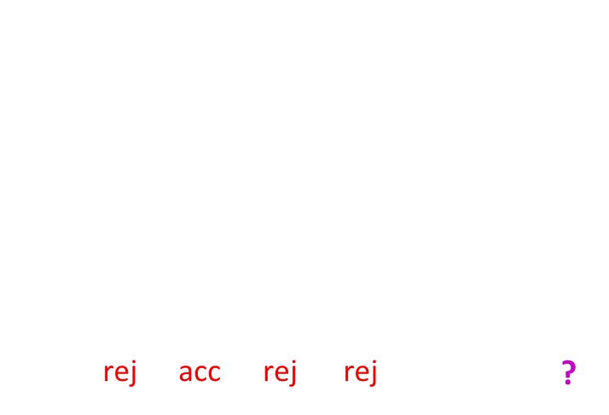
$A\text{TM}$ is undecidable
Recall $A\text{TM}$ $=\{〈M,w〉| M$ is a TM and $M$ accepts $w\}$
Theorem: $A\text{TM}$is not decidable
Proof by contradiction: Assume some TM $H$ decides $A\text{TM}$.
So $H$ on $〈M,w〉=\left\{\begin{aligned}\text{Accept} \text{if} M \text{accepts} w \\ \text{Reject} \text{if} \text{not} \end{aligned}\right.$
Use $H$ to construct TM $D$
$D=$“On input $〈M〉$
1. Simulate $H$ on input $〈M,〈M〉〉$
2. Accept if $H$ rejects. Reject if $H$ accepts.”
$D$ accepts $〈M〉$ iff $M$ doesn’t accept $〈M〉$ .
$D$ accepts $〈D〉$ iff $D$ doesn’t accept $〈D〉$ .
Contradiction.
Why is this proof a diagonalization?
All TMs
All TM descriptions:
 | $$〈M_{1}〉$$ | $$〈M_{2}〉$$ | $$〈M_{3}〉$$ | $$〈M_{4}〉$$ | . . . | $$〈D〉$$
$$M_{1}$$ | acc | rej | acc | acc | . . .
$$M_{2}$$ | rej | rej | rej | rej
$$M_{3}$$ | acc | acc | acc | acc | . . .
$$M_{4}$$ | rej | rej | acc | acc
$$⋮$$ |  |  | $$⋮$$
$$D$$ | rej | acc | rej | rej |  | ?
acc
rej
acc
acc

Slide 8


Slide 9
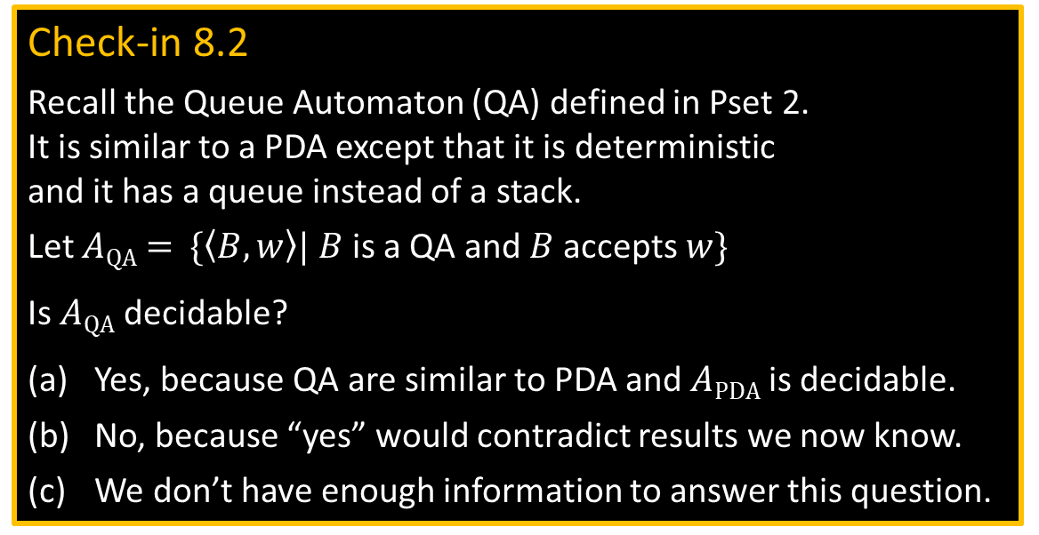
Check-in 8.2
Recall the Queue Automaton (QA) defined in Pset 2.
It is similar to a PDA except that it is deterministic
and it has a queue instead of a stack.
Let $A\text{QA}$ $=$ $\{〈B,w〉| B$ is a QA and $B$ accepts $w\}$
Is $A\text{QA}$ decidable?
Yes, because QA are similar to PDA and $A\text{PD}\text{A}$ is decidable.
No, because “yes” would contradict results we now know.
We don’t have enough information to answer this question.
Check-in 8.2

Slide 10




$\overline{A\text{TM}}$ is T-unrecognizable
Theorem: If $A$ and $\overline{A}$ are T-recognizable then $A$ is decidable
Proof: Let TM $M_{1}$ and $M_{2}$ recognize $A$ and $\overline{A}$.
Construct TM $T$ deciding $A$.
$T=$ “On input $w$
1. Run $M_{1}$ and $M_{2}$ on $w$ in parallel until one accepts.
2. If $M_{1}$ accepts then accept.
If $M_{2}$ accepts then reject.”
Corollary: $\overline{A\text{TM}}$ is T-unrecognizable
Proof: $A\text{TM}$ is T-recognizable but also undecidable
Check-in 8.3
From what we’ve learned, which closure properties
can we prove for the class of T-recognizable languages?
Choose all that apply.
Closed under union.
Closed under intersection.
Closed under complement.
Closed under concatenation.
Closed under star.
Complement of
T-recognizable =
co-T-recognizable
T-recognizable
$$\overline{A\text{TM}}$$
$A\text{TM}$
decidable
Check-in 8.3

Slide 11

The Reducibility Method
Use our knowledge that $A\text{TM}$ is undecidable to show other problems are undecidable.
Defn: $HALT\text{TM}$ $=\left\{〈M,w〉\right| M$halts on input $w\}$
Theorem: $HALT\text{TM}$ is undecidable
Proof by contradiction, showing that $A\text{TM}$ is reducible to $HALT\text{TM}$:
Assume that $HALT\text{TM}$ is decidable and show that $A\text{TM}$ is decidable (false!).
Let TM $R$ decide $HALT\text{TM}$.
Construct TM $S$ deciding $A\text{TM}$.
$S=$ “On input $〈M,w〉$
1. Use $R$ to test if $M$ on $w$ halts. If not, reject.
2. Simulate $M$ on $w$ until it halts (as guaranteed by $R$).
3. If $M$ has accepted then accept.
If $M$ has rejected then reject.
TM $S$ decides $A\text{TM}$, a contradiction. Therefore $HALT\text{TM}$ is undecidable.

Slide 12

Quick review of today
Showed that $ℕ$ and $ℝ$ are not the same size
to introduce the Diagonalization Method.
$A\text{TM}$ is undecidable.
If $A$ and $\overline{A}$ are T-recognizable then $A$ is decidable.
$\overline{A\text{TM}}$ is T-unrecognizable.
Introduced the Reducibility Method to show that $HALT\text{TM}$ is undecidable.

